Slide 1
Customer purchase behavior in retail using data analytics
Shabeeb Althaf M B- MBT8
Version Control 1.0.

Slide 2
Project Objective
This is a Capstone Project to learn data analysis and graphical display utilizing Excel, SQL and Power BI in a retail and e-commerce dataset.
Proficiency in Excel:
Ability to clean and pre-process data using Excel's functions and tools.
Competence in performing statistical analysis, creating pivot tables, and visualizing data through charts and graphs.
SQL Query Skills:
Proficiency in writing and executing SQL queries to retrieve, manipulate, and aggregate data.
Understanding of joins, subqueries, and aggregate functions to extract meaningful insights from relational databases.
Power BI Expertise:
Capability to import and integrate data from multiple sources into Power BI.
Skill in building interactive dashboards and reports that effectively communicate insights using various visualizations and customizations.
Data Analysis Proficiency:
Competence in analysing data trends, patterns, and anomalies to derive actionable insights.
Ability to create calculated columns, measures, and KPIs using DAX to perform advanced data calculations.
Business Applications:
Application of data analytics skills to real-world business scenarios such as sales performance analysis, customer segmentation, and inventory management.
Presentation of findings and recommendations to support strategic decision-making and business growth.
Hands-on Project Experience:
Practical experience in handling a comprehensive data analytics project from data preparation to visualization and analysis.
Confidence in using Excel, SQL, and Power BI tools independently for future data-related projects and tasks.

Slide 3
Data Transformation
Before
After

Slide 4
Basic Summary Statistics:
Excel Questions
Task 1: Calculate the summary statistics (mean, median, mode & standard deviation) for the list price of the products.
Task 2: Create a pivot table to summarize total sales (quantity * list price) by store and by product category.

Slide 5
Task 3: Highlight the top 10 products based on total sales.
Task 4: Identify and correct any inconsistencies or missing data in the customers table.
Solution: All the NULL values have been assigned a common phone number in order to avoid NULL values in the dataset and customer name has been merged.

Slide 6
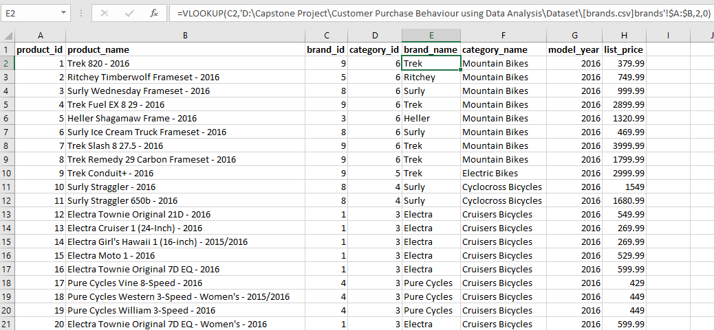
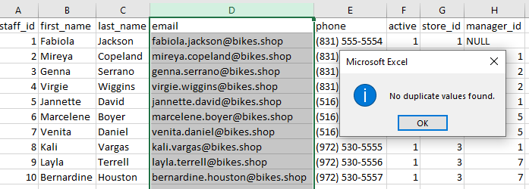
Task 5: Use VLOOKUP to match products names with their respective categories and brands
Task 6: Data validation to ensure all email address in the staffs table are unique and correctly formatted.

Slide 7
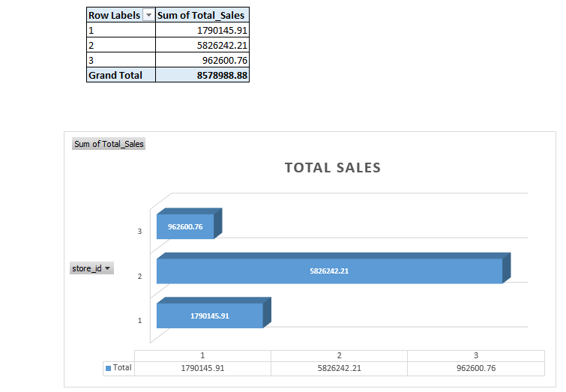
Task 7: Create a bar chart to visualize the total sales by store.

Slide 8
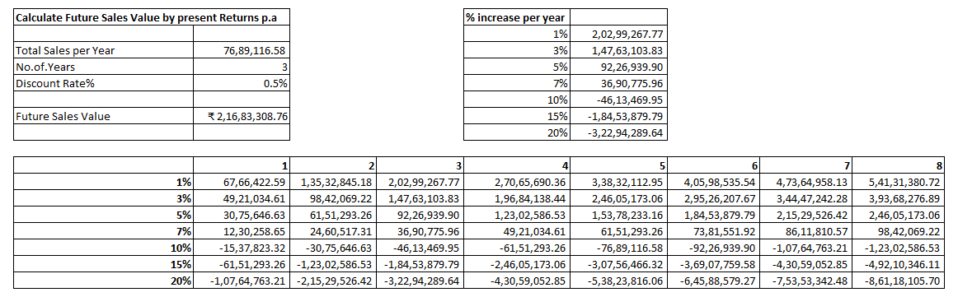
Task 8: Perform What-If-Analysis to see how changes in discount rates affect total sales.

Slide 9
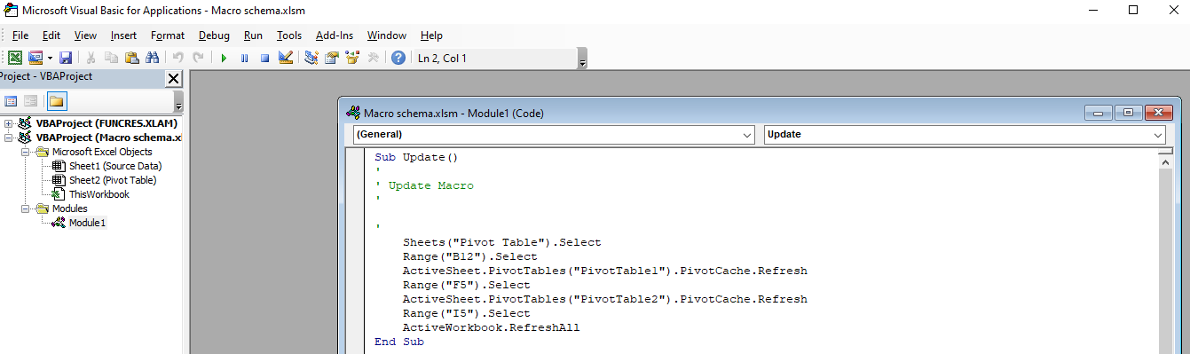
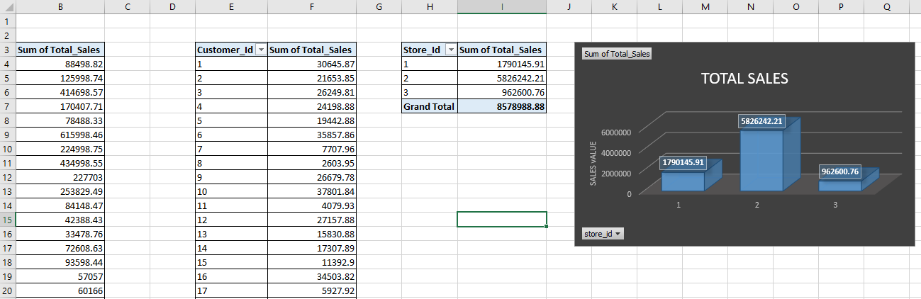
Task 9: Automate the process of updating sales reports.
Task: Use Excel macros to automate repetitive tasks, such as updating pivot tables and charts.

Slide 10
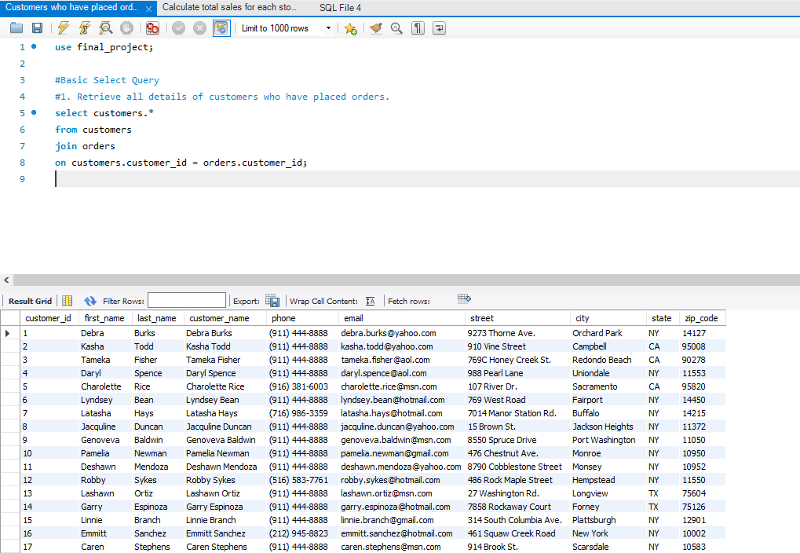
Basic Select Query: SQL
Question 1: Retrieve all details of customers who have placed orders.
Task: Write a SQL query to join the customers and orders tables and select relevant customer details.

Slide 11
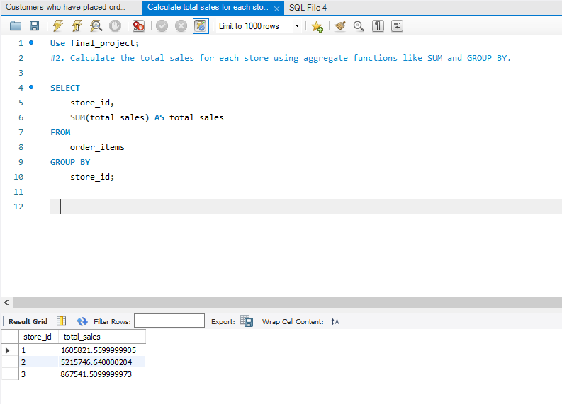
Aggregate Functions:
Question 2: Calculate the total sales for each store.
Task: Use aggregate functions like SUM and GROUP BY to calculate total sales from the orders and order_items tables.

Slide 12
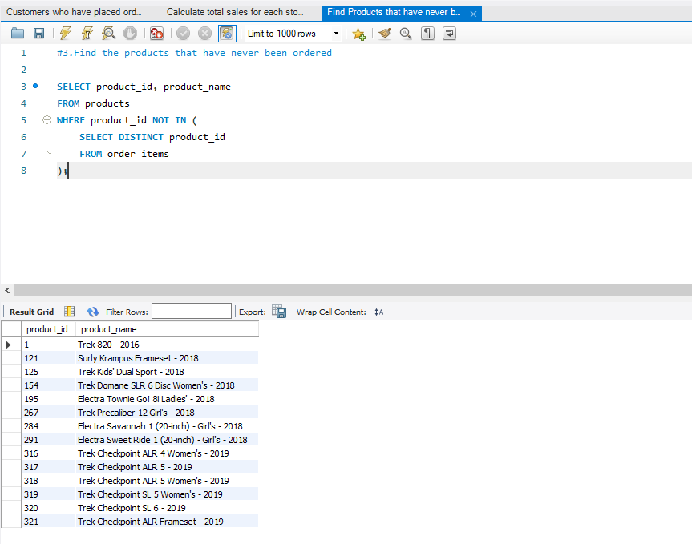
Subqueries:
Question 3: Find the products that have never been ordered.
Task: Write a subquery to identify products in the products table that do not appear in the order_items table.

Slide 13
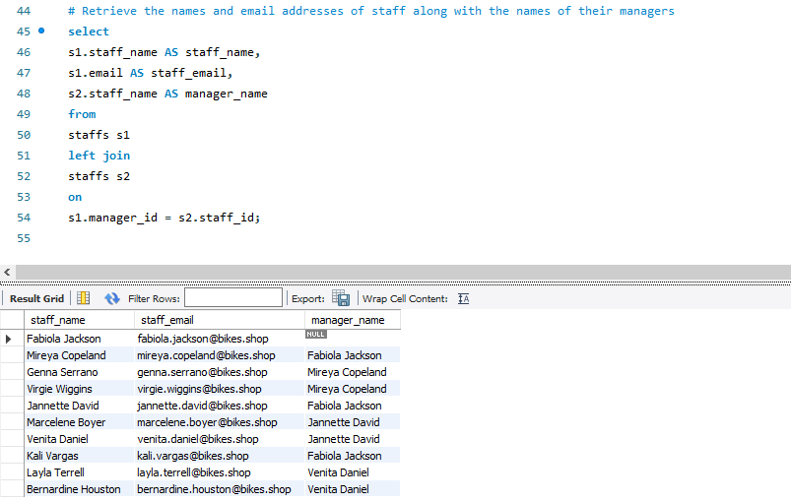
Joins:
Question 4: Retrieve the names and email addresses of staff along with the names of their managers.
Task: Write a SQL query to join the staffs table with itself to get staff and their manager information.

Slide 14
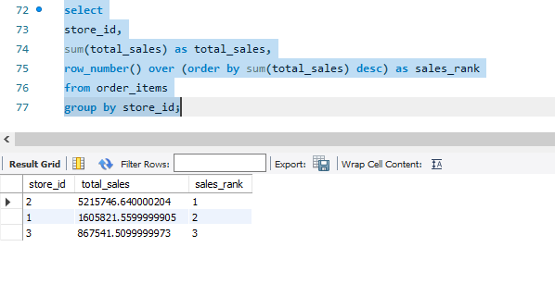
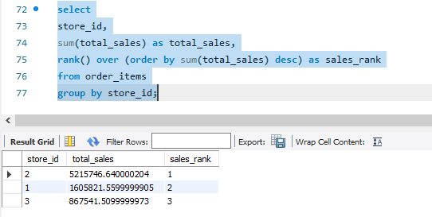
Window Functions:
Question 5: Rank stores based on their total sales.
Task: Use window functions like ROW_NUMBER() or RANK() to rank stores based on total sales.

Slide 15
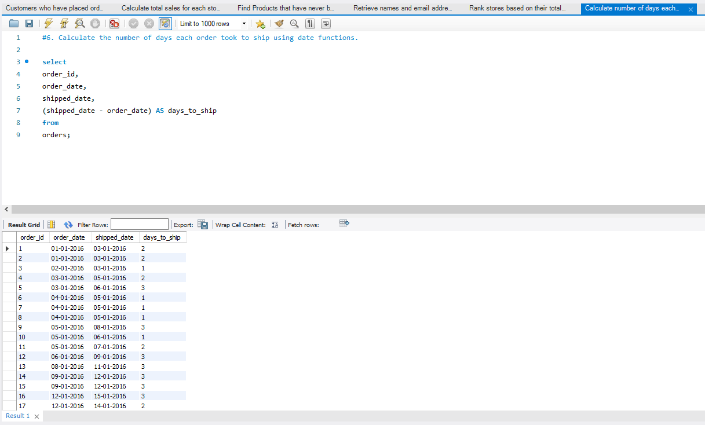
Date Functions:
Question 6: Calculate the number of days each order took to ship.
Task: Use date functions to calculate the difference between shipped_date and order_date in the orders table.

Slide 16
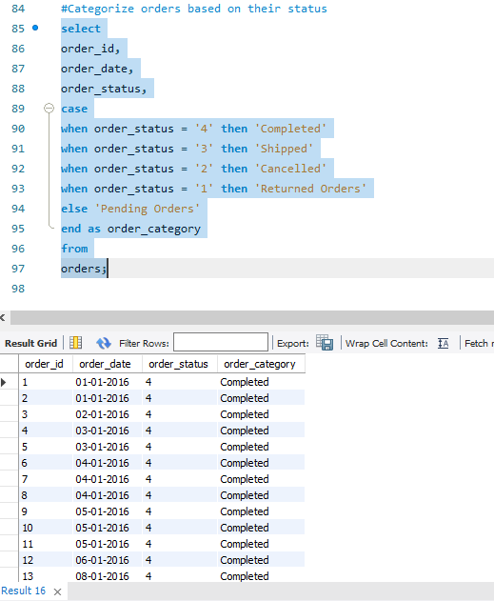
Case Statements:
Question 7: Categorize orders based on their status.
Task: Use CASE statements to categorize orders in the orders table into different status groups.

Slide 17
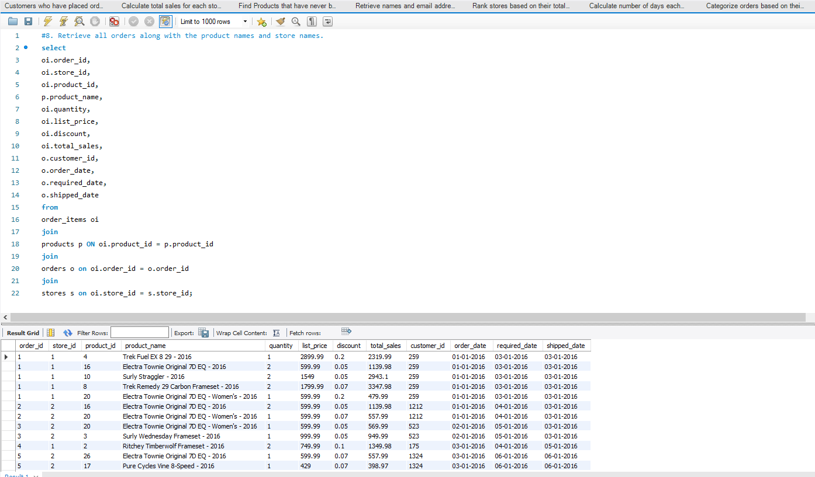
Complex Joins:
Question 8: Retrieve all orders along with the product names and the store names.
Task: Write a SQL query to join the orders, order_items, products, and stores tables.

Slide 18
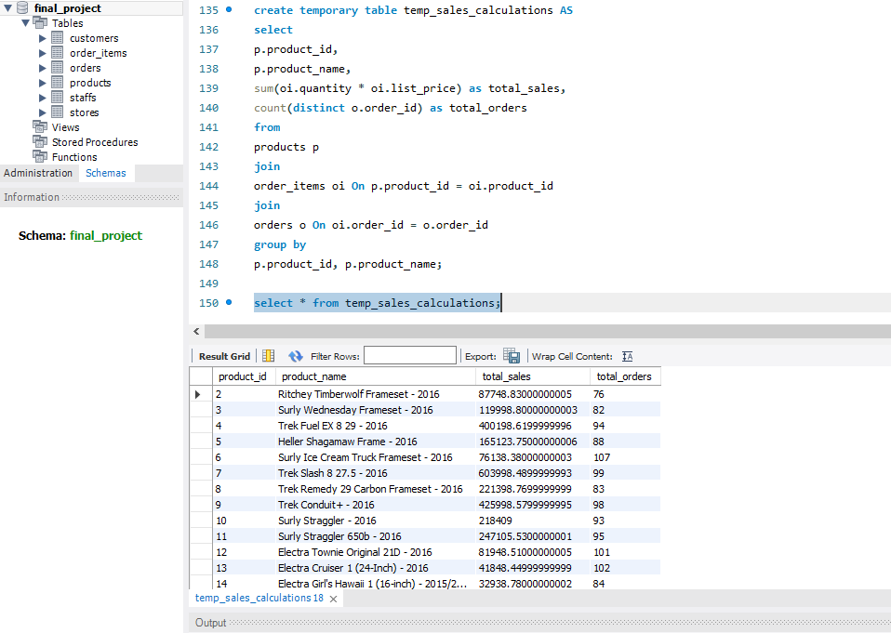
Temporary Tables:
Question 9: Create a temporary table to store intermediate sales calculations.
Task: Use CREATE TEMPORARY TABLE to store results of a complex calculation for further analysis.

Slide 19
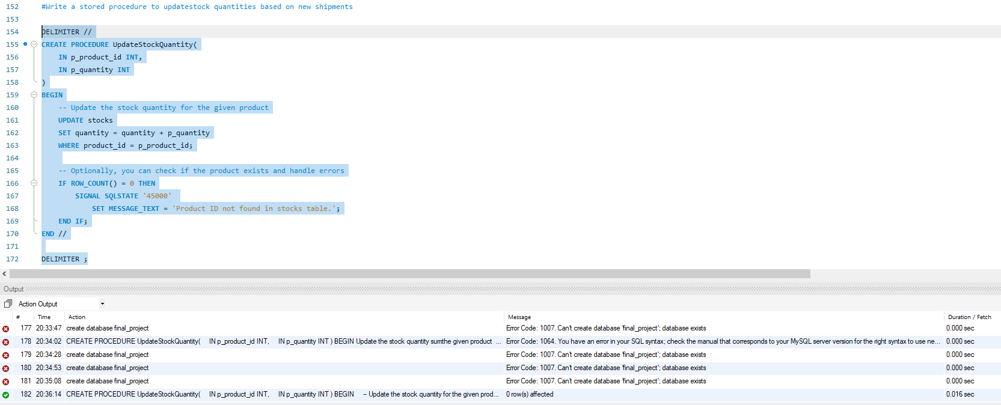
Stored Procedures:
Question 10: Write a stored procedure to update stock quantities based on new shipments.
Task: Create a stored procedure that updates the stocks table based on incoming shipment data.

Slide 20
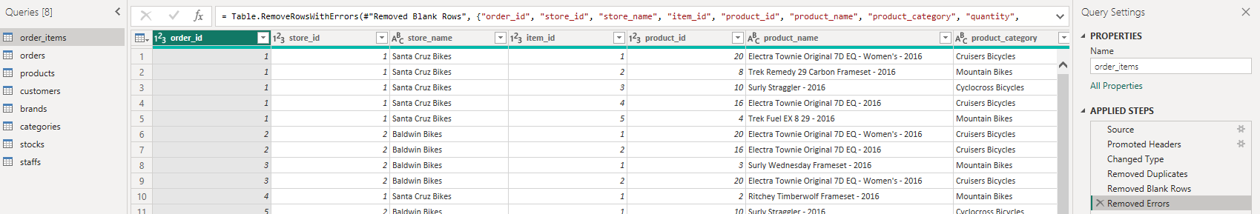
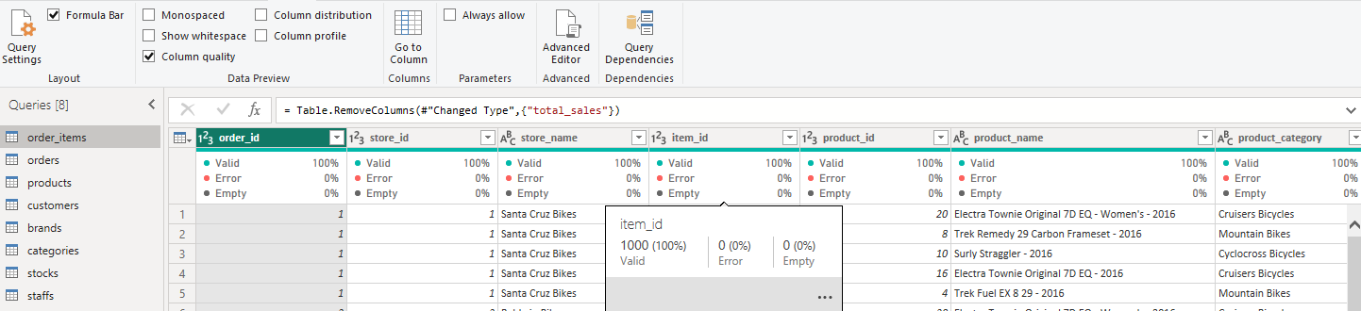
Power BI
Question 1: Clean and transform data from multiple tables before loading into the Power BI model.
Task: Use Power Query in Power BI to perform data cleaning and transformation_tasks.

Slide 21
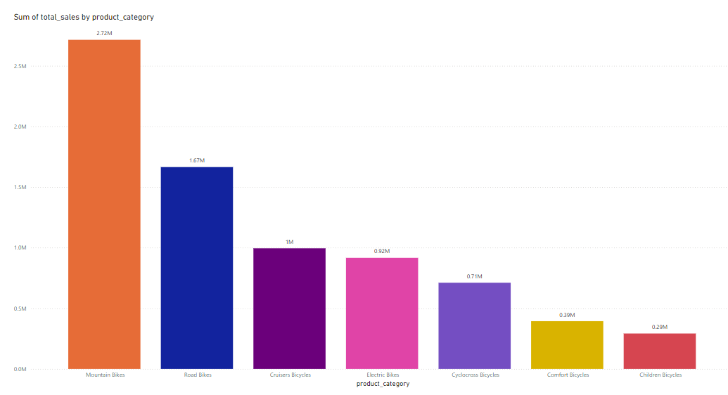
Question 2: Create a bar chart to show total sales by product category.
Task: Use Power BI to import data and create a bar chart visualizing sales by category.

Slide 22
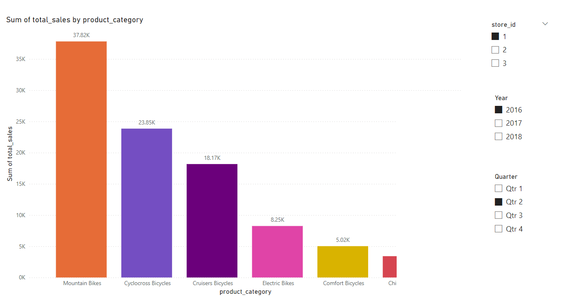
Question 3: Add slicers to filter sales data by store and date range.
Task: Use slicers in Power BI to allow users to filter sales data interactively.

Slide 23
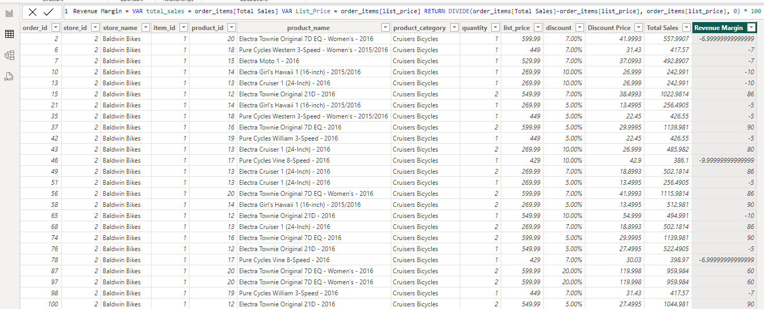
Question 4: Create a calculated column to show the profit margin for each order item.
Task: Use DAX in Power BI to create a calculated column for profit margin in the order_items table.
If you cannot estimate cost price but want to show some form of margin, you could treat the List Price as the "expected" revenue and compare that with the Total Sales to see the deviation in terms of revenue margin.

Slide 24
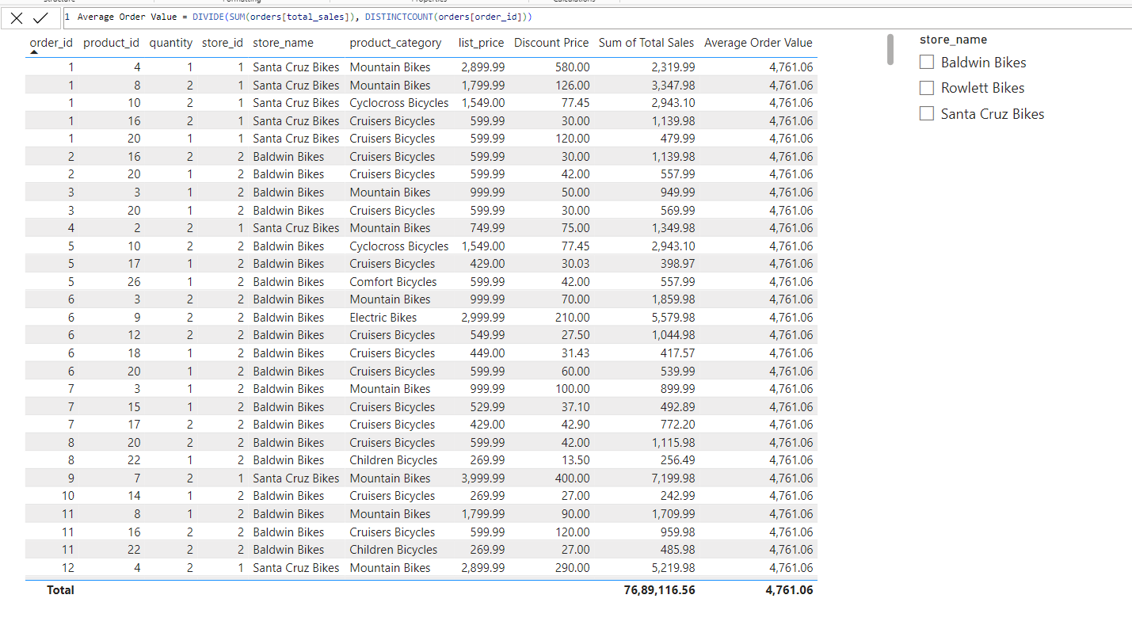
Question 5: Create a measure to calculate the average order value.
Task: Use DAX to create a measure for average order value in Power BI.
The Average Order Value (AOV) is generally calculated by dividing the total sales by the number of orders.

Slide 25
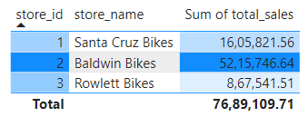
Question 6: Apply conditional formatting to highlight top-performing stores.
Task: Use conditional formatting in Power BI to highlight stores with the highest sales.

Slide 26
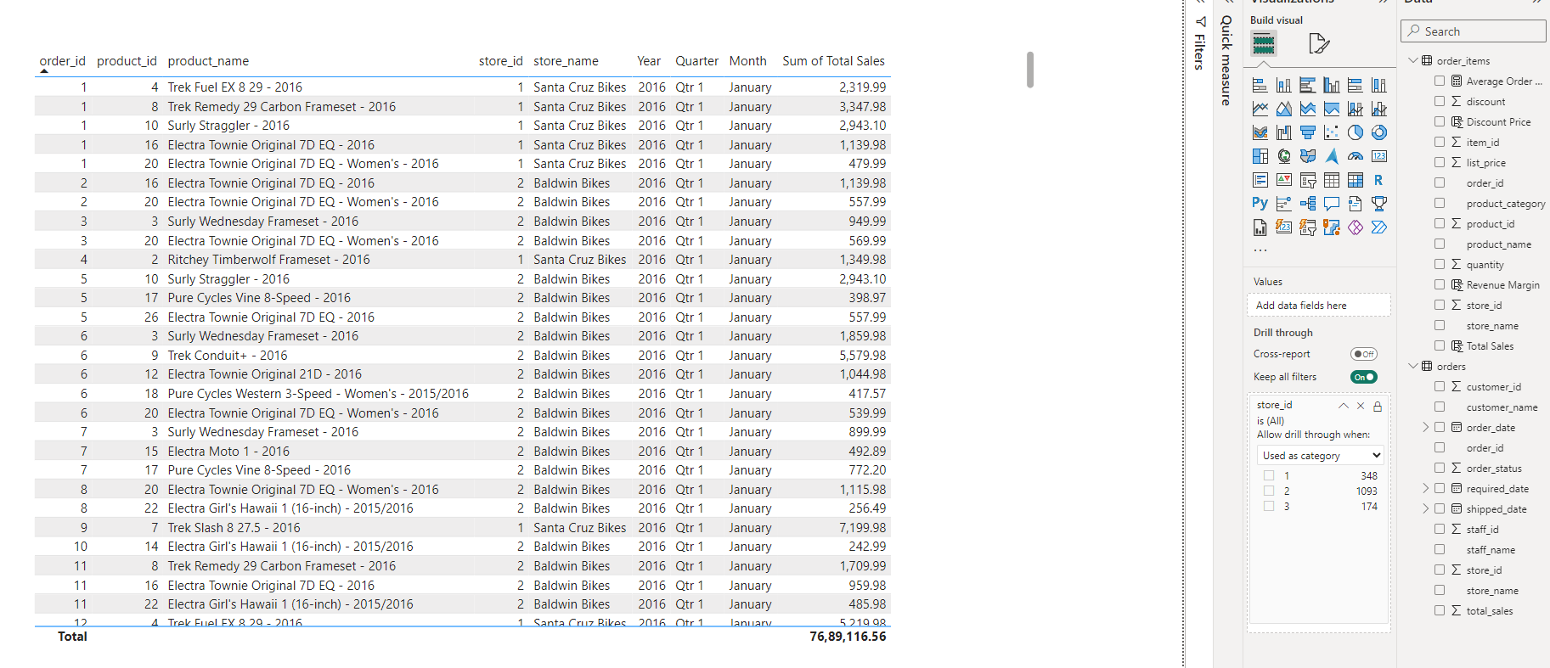
Question 7: Create a hierarchy for drill-down analysis of sales data by year, month, and day.
Task: Create a date hierarchy in Power BI to enable drill-down capabilities.

Slide 27
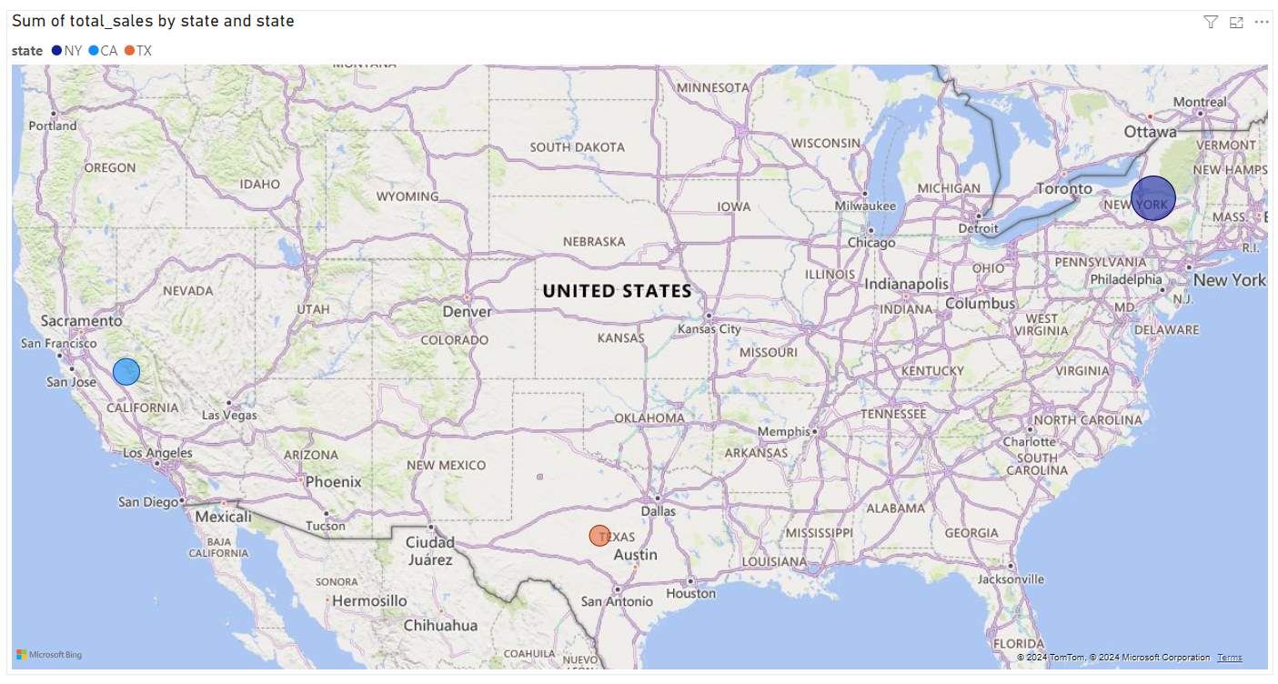
Question 8: Utilize custom visuals to display geographic sales data.
Task: Import and use custom visuals in Power BI to enhance data representation.

Slide 28
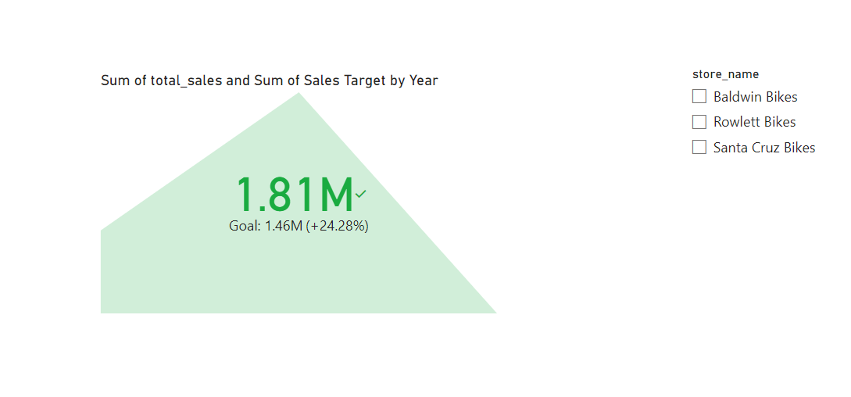
Question 9: Create KPIs to track sales targets versus actual sales.
Task: Use Power BI's KPI visuals to display and track sales targets against actual performance.

Slide 29
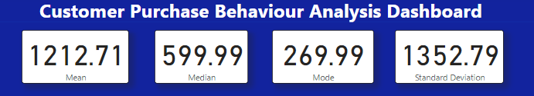
From Excel to Power BI
Task 1: Import the summary statistics table for list_price calculated in Excel into Power BI.
Subsequent Analysis:
Create a card visualization in Power BI to display each summary statistic (mean, median, mode, standard deviation) for list_price.
Use these cards in a dashboard to give an overview of product pricing.

Slide 30
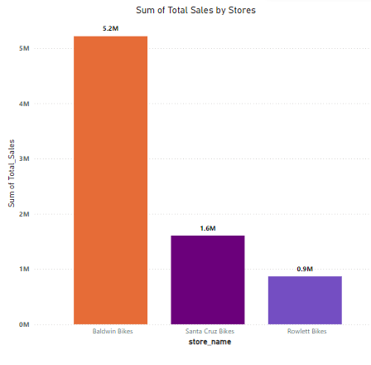
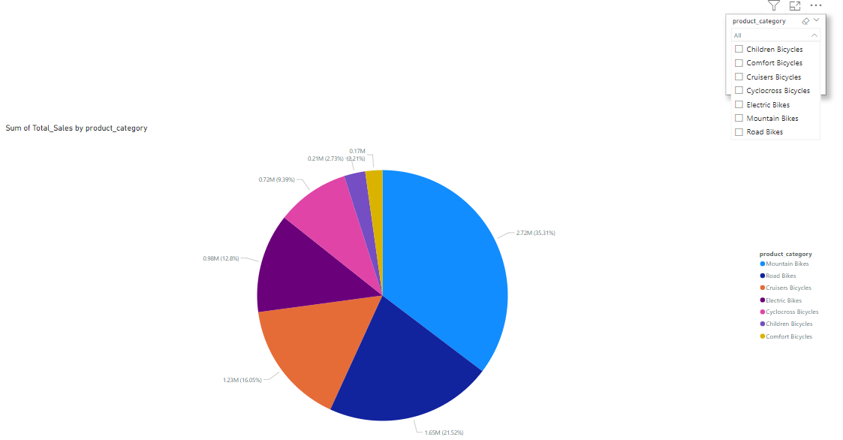
Task 2: Import the pivot table summarizing total sales by store and by product category into Power BI.
Subsequent Analysis:
Create a bar chart in Power BI to visualize total sales by store.
Create a pie chart to show the distribution of sales by product category.
Add slicers to filter the visualizations by store and category.

Slide 31
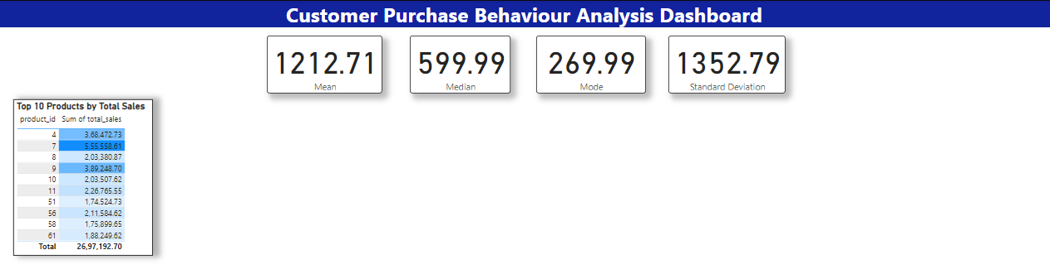
Task 3: Import the highlighted top 10 products based on total sales from Excel into Power BI.
Subsequent Analysis:
Create a table visualization in Power BI to display the top 10 products.
Add conditional formatting to highlight these products in the table.
Use this table in a dashboard for quick insights.

Slide 32
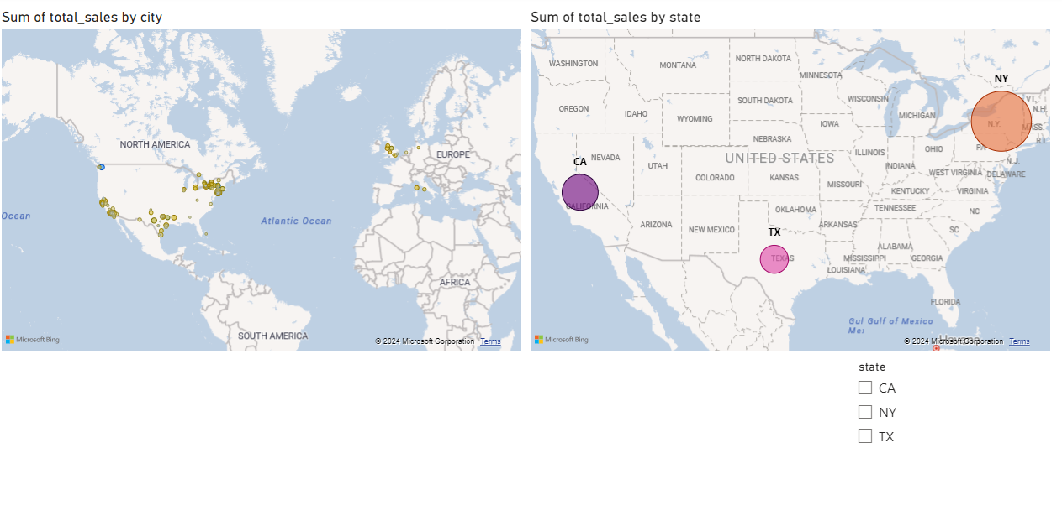
Task 4: Import the cleaned customers data from Excel into Power BI.
Subsequent Analysis:
Create a map visualization in Power BI to display customer locations based on their city and state.
Use slicers to filter customer data by state or zip code.

Slide 33
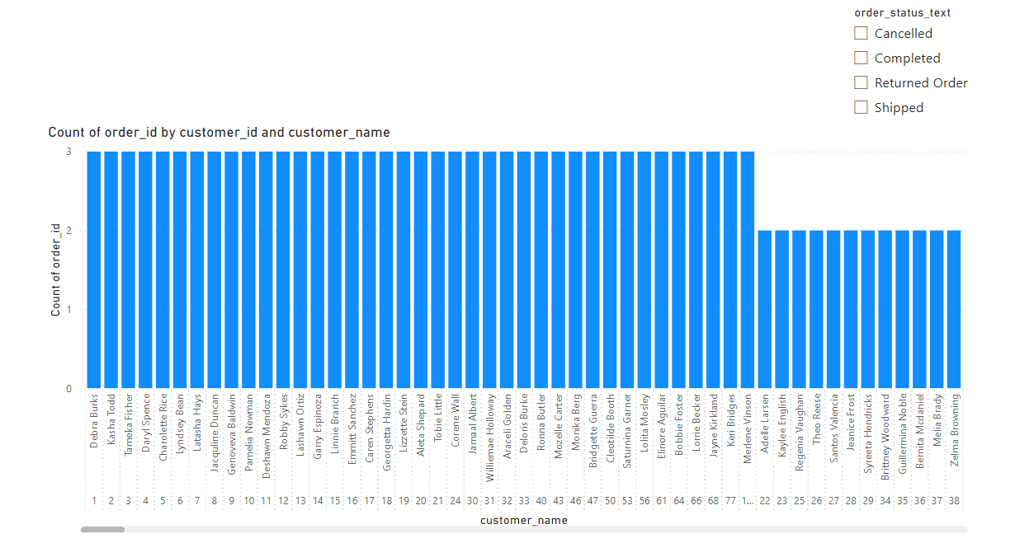
SQL to Power BI Task 1: Import the result of the query retrieving details of customers who have placed orders into Power BI.
Subsequent Analysis:
Create a clustered column chart to visualize the number of orders placed by each customer.
Add a slicer to filter orders by order status

Slide 34
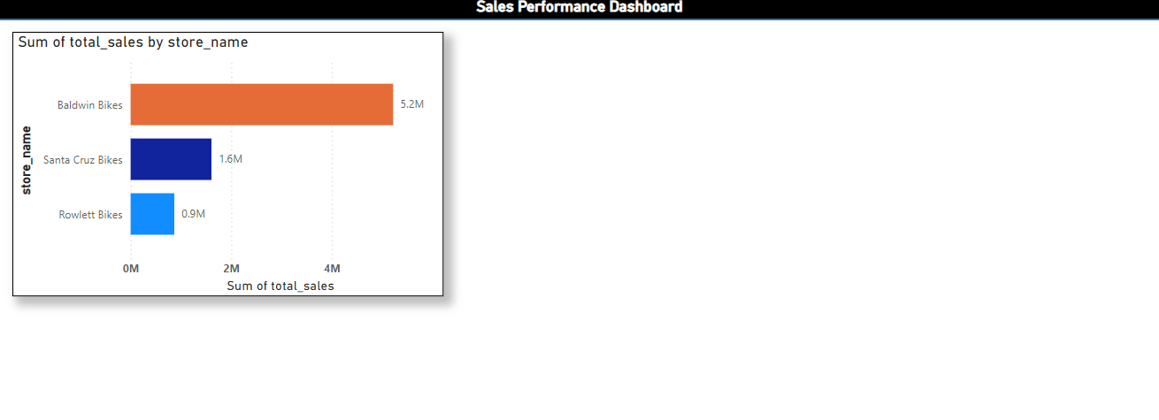
Task 2: Import the result of the query calculating total sales for each store into Power BI.
Subsequent Analysis:
Create a bar chart to visualize total sales by store.
Use this bar chart in a sales performance dashboard.

Slide 35
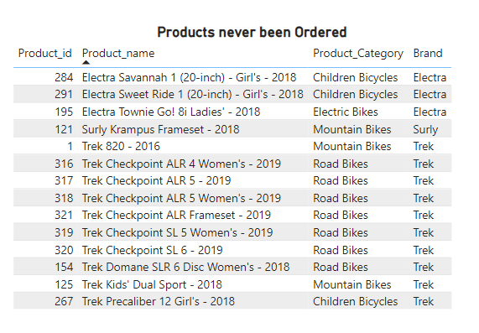
Task 3: Import the result of the query finding products that have never been ordered into Power BI.
Subsequent Analysis:
Create a table visualization to display products that have never been ordered.
Add filters to allow analysis by product category or brand.

Slide 36
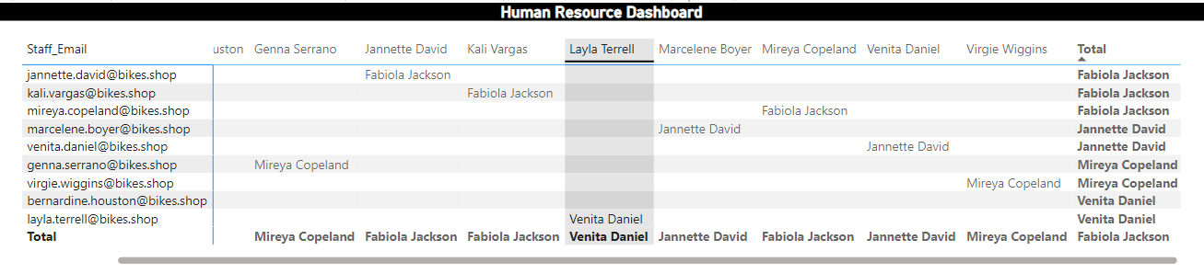
Task 4: Import the result of the query retrieving staff names and their manager names into Power BI.
Subsequent Analysis:
Create a matrix visualization to display staff members along with their managers.

Slide 37
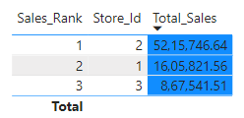
Task 5: Import the result of the query ranking stores based on total sales into Power BI.
Subsequent Analysis:
Create a table visualization to display the ranked list of stores.
Add conditional formatting to highlight the top-performing stores.

Slide 38
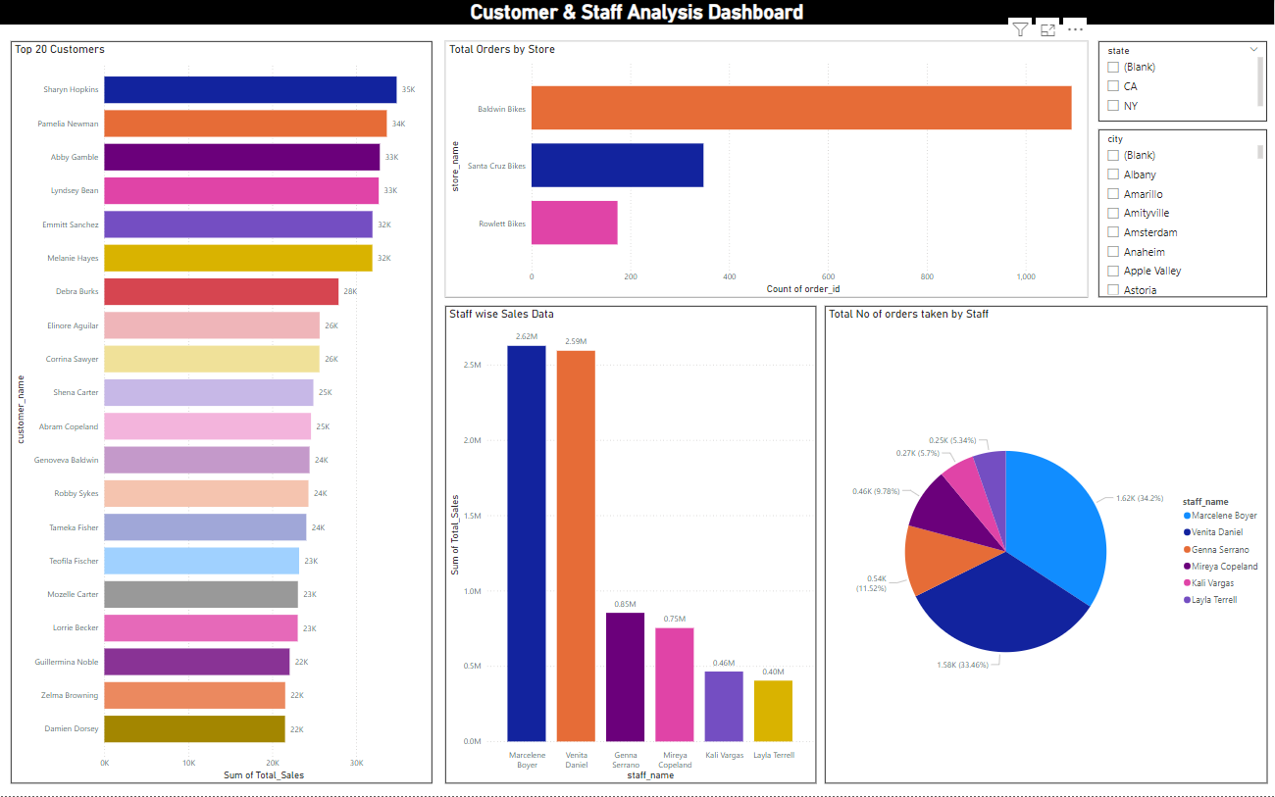

Slide 39
Business Insights:
Top 20 Customers:
The highest sales come from Sharyn Hopkins ($35K), followed by Pamela Newman ($34K).
Several customers like Lyndsey Bean, Abby Gamble, and Emmitt Sanchez contribute similar amounts to sales, indicating a well-distributed customer base at the top tier.
Total Orders by Store:
Baldwin Bikes is the top-performing store with a significantly higher order count, indicating a strong customer base and sales performance compared to Santa Cruz Bikes and Rowlett Bikes.
Staff-wise Sales Data:
Venita Daniel leads in total sales with $2.99M, closely followed by Marcelene Boyer with $2.62M. This indicates strong performance from these two staff members.
There is a noticeable gap between these two and other staff members like Genna Serrano ($0.85M) and Mireya Copeland ($0.75M).
Total Number of Orders Taken by Staff:
Marcelene Boyer and Venita Daniel together account for nearly 50% of the total orders (34.2% and 13.46%, respectively). Their order volume matches their sales, showing they are high performers both in quantity and revenue generation.
Other staff members handle a smaller portion of the orders, which could indicate capacity or performance issues.
Recommendations:
Customer Engagement:
The top 20 customers contribute significantly to sales. Implementing a loyalty program or providing personalized offers to these top customers could help increase their repeat purchases.
Focus on nurturing mid-tier customers like Debra Burks and Elmore Aguilar to encourage higher spending and increase their loyalty.
Store Performance:
Baldwin Bikes is performing exceptionally well. Consider expanding or replicating the strategies used in this store to Santa Cruz Bikes and Rowlett Bikes to balance performance across all locations.
Investigate factors behind the low order count in Rowlett Bikes and explore targeted marketing or operational improvements.
Staff Performance Management:
Marcelene Boyer and Venita Daniel are strong performers. Consider rewarding these employees and providing them with additional responsibilities such as mentoring other staff members to boost overall team performance.
For lower-performing staff members, like Kali Vargas and Layla Terrell, evaluate their performance metrics, provide targeted training, and set measurable sales goals to help them improve.
Balanced Workload Distribution:
Ensure that other staff members handle a more balanced share of the orders to reduce dependency on top performers like Marcelene Boyer and Venita Daniel. Redistributing the workload may enhance overall efficiency and employee satisfaction.

Slide 40
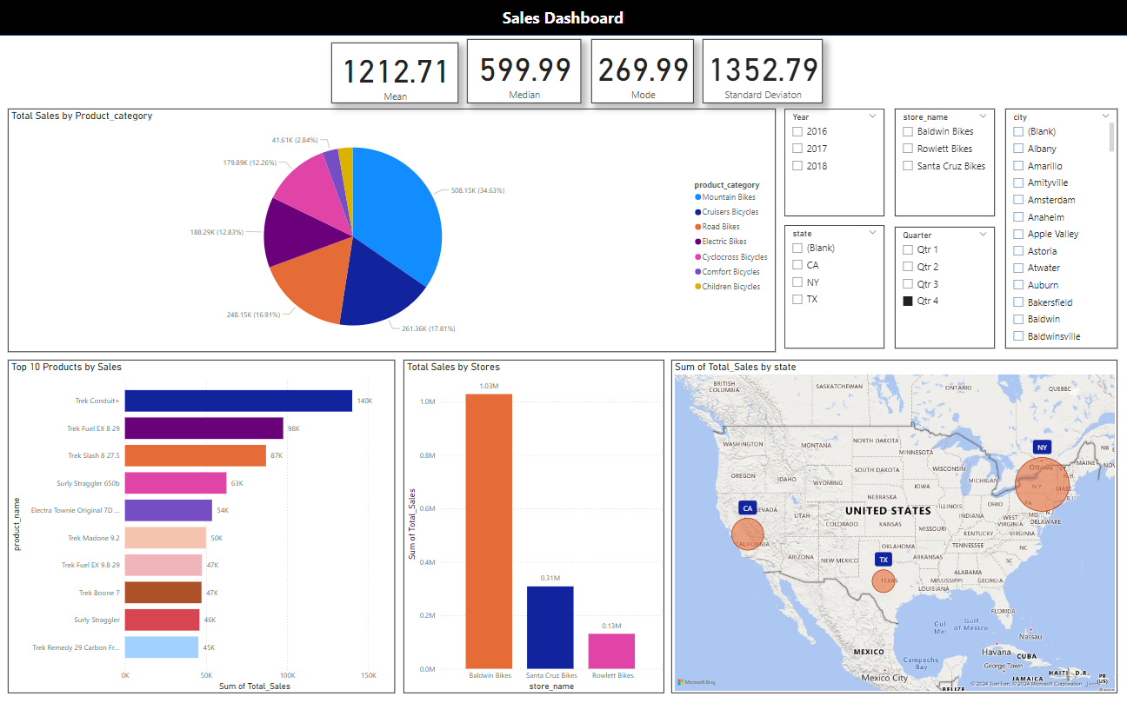

Slide 41
Business Insights:
Total Sales by Product Category:
Mountain Bikes contribute the most to total sales, accounting for 34.63%, followed by Cruisers Bicycles (17.81%) and Road Bikes (16.91%).
Categories like Children Bicycles and Comfort Bicycles have minimal contributions, representing potential underperforming product lines.
Top 10 Products by Sales:
The top-selling product is Trek Conduit+ with $140K in sales, followed by Trek Fuel EX 8 29 ($98K) and Trek Slash 8 27.5 ($87K).
There is a significant drop in sales between the top three products and the others, indicating a strong preference for certain models.
Total Sales by Store:
Baldwin Bikes leads sales with over $1M, significantly outperforming other stores like Santa Cruz Bikes ($0.31M) and Rowlett Bikes ($0.13M).
The gap between stores suggests that the sales strategies or market conditions in Baldwin Bikes are much more favorable.
Geographical Sales Distribution:
Sales are concentrated in California (CA), Texas (TX), and New York (NY). California has the highest sales, which could indicate a larger customer base or more active marketing in this region.
States with lower sales contributions may present opportunities for market expansion.
Sales Metrics:
Key statistics like the mean ($1212.71), median ($599.99), and mode ($269.99) indicate that most sales are clustered around the lower range of values, but there are high-value outliers driving the mean up.
A high standard deviation of $1352.79 suggests significant variability in the sales amounts across different transactions.
Recommendations:
Focus on Best-Selling Products:
Continue to stock and promote best-selling products like the Trek Conduit+ and Trek Fuel EX 8 29 to maximize revenue.
Consider creating promotional campaigns or discounts for lower-performing products in the Top 10 list to improve their sales or phase them out to focus on better-performing items.
Enhance Performance of Underperforming Stores:
Analyze the operations and marketing strategies used at Baldwin Bikes to replicate its success in stores like Rowlett Bikes and Santa Cruz Bikes.
Invest in localized marketing campaigns, staff training, and inventory management to boost performance in underperforming locations.
Explore Market Expansion:
Consider expanding operations or marketing efforts in states with lower sales contributions. Regions outside of CA, TX, and NY present opportunities for growth.
Explore partnerships with local retailers or online sales strategies to tap into underserved areas.
Optimize Sales Strategies for Low-Performing Categories:
Products like Children Bicycles and Comfort Bicycles show limited sales potential. Reassess the demand for these categories and explore targeted promotions, bundling strategies, or reducing inventory to focus on higher-margin products.
Refine Sales Promotions:
The data suggests most sales are in the lower range (median at $599.99 and mode at $269.99), with outliers driving up the mean. Consider offering mid-range pricing bundles or loyalty discounts to encourage more frequent high-value purchases.
By leveraging these insights and adjusting strategies accordingly, the company can enhance performance, boost sales across underperforming stores, and target new markets.

Slide 42
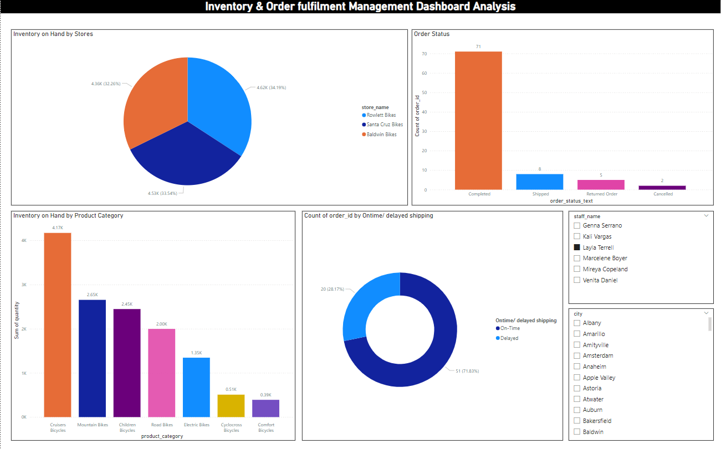

Slide 43
Business Insights:
Inventory Levels:
High Inventory: Certain product categories, such as “Electra Amsterdam Fashion 31 Ladies” and “Electra Cruiser 1 Ladies,” have high inventory levels. This could indicate overstocking or lower-than-expected sales.
Low Inventory: Other categories, like “Children Bicycles” and “Comfort Bicycles,” have relatively low inventory levels, which might suggest higher demand or insufficient stock replenishment.
Order Status:
The dashboard shows a significant number of orders in the “Pending” or “Processing” stages. This could indicate potential bottlenecks in the order fulfillment process.
Inventory by Store:
Some stores have higher inventory levels compared to others. This could be due to regional demand variations or differences in sales performance.
Recommendations:
Inventory Management:
Optimize Stock Levels: Implement an inventory optimization strategy to balance stock levels across different product categories. This can help reduce holding costs and minimize stockouts.
Demand Forecasting: Use historical sales data and market trends to improve demand forecasting. This will help in better planning and stocking of inventory.
Order ful-filment:
Streamline Processes: Identify and address any bottlenecks in the order ful-filment process. This could involve automating certain tasks, improving coordination between departments, or enhancing the efficiency of the supply chain.
Monitor Order Status: Regularly monitor the status of orders to ensure timely processing and ful-filment. Implementing a real-time tracking system can help in identifying and resolving issues quickly.
Store Performance:
Analyse Store Data: Conduct a detailed analysis of store performance to understand the reasons behind varying inventory levels. This can help in making informed decisions about stock allocation and replenishment.
Regional Strategies: Develop region-specific strategies based on the performance and demand patterns of different stores. This can help in catering to local preferences and improving overall sales.

Slide 44
Thank You

